Slide 1

INSTITUTE OF AERONAUTICAL ENGINEERING
(Autonomous)
Dundigal – 500043,Hyderabad, Telangana
A Deep Learning Model for fine grained malware
feature extraction and variant identification
Department of Computer Science and Engineering
Bachelor of Technology
Presented by
PERKA ABHILASHA
22955A0501
NYALAKANTI ABHISHEK
22955A0503
GEDELA BASKERA VAMSHI
21951A0524
Under the Guidance of
Mr. P. Suresh Kumar
Assistant Professor

Slide 2
OUTLINE:
Abstract
Problem statement
Existing System & Proposed System
Architecture of the Project
Requirements
Algorithms
Modules
Methodology
Results
References

Slide 3
ABSTRACT:
As Android dominates the smartphone market, it's become a bullseye for malware creators, rendering traditional detection methods obsolete. This research tackles this critical issue by leveraging machine learning to identify malicious apps on Android devices. Their approach is two-pronged: firstly, they utilize a wider range of informative features to analyze apps, and secondly, they combine various machine learning algorithms, including AdaBoost, to boost detection accuracy. Trained on a colossal dataset of recent malware samples, their model achieves a remarkable 96.24% success rate in identifying malware with minimal false positives. This innovative approach using machine learning offers a significant leap forward in the fight against Android malware, providing a more robust defense for smartphone users.

Slide 4
PROBLEM STATEMENT:
Existing Android malware detection methods have limitations. While some studies achieve good accuracy (e.g., 91% with 700 samples), they might use limited datasets and feature sets, making them vulnerable to new malware. Other approaches focus on specific techniques like system calls, which might not be comprehensive enough. Additionally, not all existing systems leverage machine learning, a powerful tool for improving detection. Finally, a lack of transparency in some studies makes it difficult to assess their generalizability. To address these shortcomings, the proposed system incorporates machine learning, a wider range of features extracted through reverse engineering, and a larger dataset of recent malware samples for more robust and adaptable detection of Android malware.

Slide 5
EXISTING SYSTEM:
Relies on predefined patterns (signatures) of known malware.
Requires constant updates to keep up with new malware variants.
may produce false positive if heuristic rules are overly broad.
The system is not implemented MACHINE LEARNING ALGORITHM AND ENSEMBLE LEARNING.
The system is not implemented Reverse Engineered Applications characteristics.

Slide 6
PROPOSED SYSTEM:
The proposed system chooses the characteristics based on their capability to display all data sets. Enhanced efficiency by reducing the dataset size and the hours wasted on the classification process introduces an effective function selection process.
The system used in this study also incorporates larger feature sets for classification. Although this problem arises in machine learning quite often to some extent choosing the type of model for detection or classification can highly impact the high dimensionality of the data being used.

Slide 7
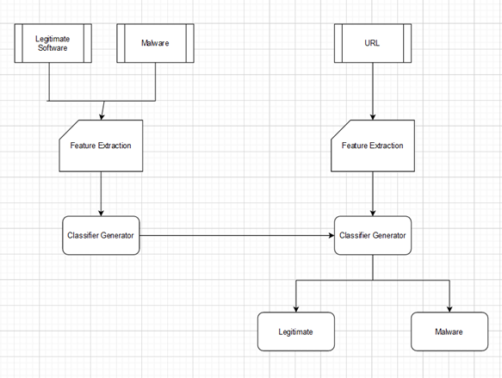
ARCHITECTURE DESIGN :

Slide 8
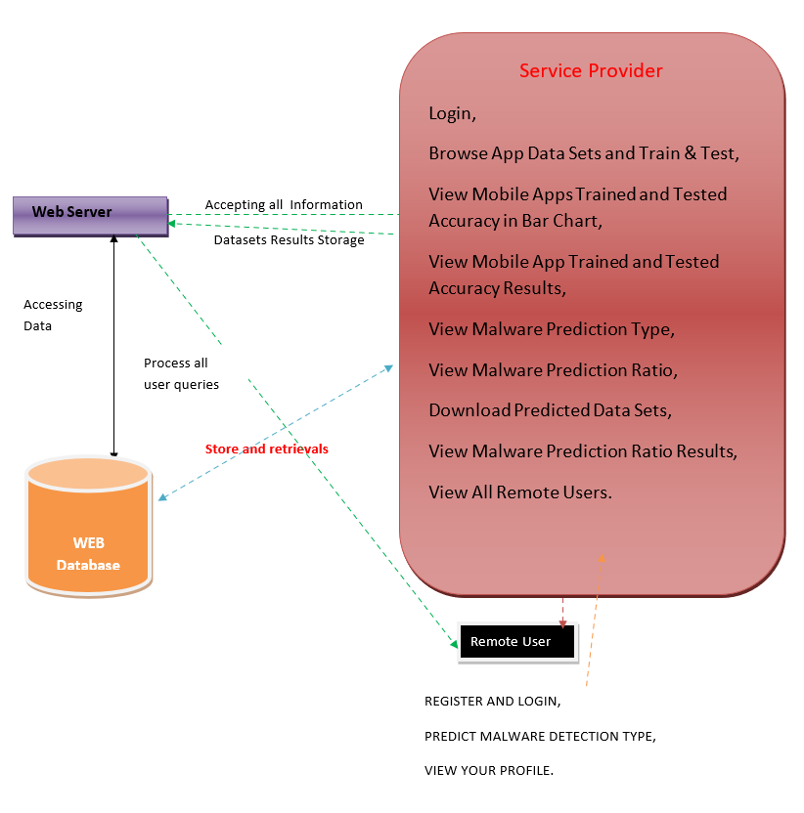
System Architecture:

Slide 9
REQUIREMENTS
SOFTWARE REQUIREMENTS:
Operating System – Windows 11
Python, Html, css,TKInter
Django-ORM
MySQL WAMP Server
HARDWARE REQUIREMENTS:
Processor-Pentinum VI
RAM- 4GB
Hard Disk- 20 GB

Slide 10
FUNCTIONAL REQUIREMENTS:
Feature Extraction
Need to implement ensemble learning and machine learning
Training and testing
Classification
Detect malware
Calculate performance metrics
NON-FUNCTIONAL REQUIREMENTS:
Accuracy
Performance
Scalability
Usability
security

Slide 11
Algorithm for CNN:
Initialize the CNN model as a sequence of layers.
Add Conv2D layers to extract features from input data
Add pooling layers to downsample feature maps
Flatten the 2D output from the last convolutional/pooling layer into a 1D vector.
Add Dense layers to interpret the features
Compile the CNN model with optimizer, loss function, and metrics
Fit the model to training data
Evaluate the trained model on test data

Slide 12
ALGORITHM FOR RNN MODEL:
Initialization: The hidden state is initialized with zeros or random values.
Load and Preprocess Data
Load the dataset. Split the data into training and testing sets. Normalize the data.
Define the LSTM Model
Initialize the Sequential model. Add LSTM layers with specified units and activation functions. Add a Dropout layer to prevent overfitting. Add a Dense layer with the specified number of units and activation function.
For each element (t) in the sequence: The current element (x_t) is fed into the input layer.The current hidden state (h_(t-1)) from the previous step is retrieved. The recurrent layer processes the input (x_t) and the previous hidden state (h_(t-1)) to update the current hidden state (h_t) and generate the output (o_t).
Output: The output sequence (o_1, o_2, ..., o_T) is obtained after processing all elements in the sequence.

Slide 13
MODELS:
Decision tree classifier
Gradient boosting
K-nearest neighbors(KNN)
Logistic regression classifier
Naïve bayes
Random Forest

Slide 14
MODULES:
Data collection module
Prepocessing module
Model training module
User interface module
Data storage module
System integration module

Slide 15
METHODOLOGY:
Data Collection and Preparation
Data Acquisition
Data Preprocessing
Feature selection
model training and evaluation
Model Implementation:
Implement deep learning models using frameworks like TKInter and Keras

Slide 16
CONCLUSION:
In this Project, we devised a framework that can detect malicious Android applications. The proposed technique takes into account various elements of machine learning and achieves a 96.24% in identifying malicious Android applications. We first define and pick functions to capture and analyze Android apps' behavior, leveraging reverse application engineering and AndroGuard to extract features into binary vectors and then use python build modules and split shuffle functions to train the model with benign and malicious datasets. Our experimental findings show that our suggested model has a false positive rate of 0.3 with 96% accuracy in the given environment with an enhanced and larger feature and sample sets.

Slide 17
REFERENCES:
[1] Anderson, R., Barton, C., Böhme, R., Clayton, R., Van Eeten, M. J., Levi, M., ... & Savage, S. (2013). Measuring the cost of cybercrime. In The economics of information security and privacy (pp. 265-300). Springer, Berlin, Heidelberg.
[2] Li, B., Roundy, K., Gates, C., & Vorobeychik, Y. (2017, March). Large Scale Identification of Malicious Singleton Files. In Proceedings of the Seventh ACM on Conference on Data and Application Security and Privacy (pp. 227-238). ACM.
[3] Alazab, M., Venkataraman, S., & Watters, P. (2010, July). Towards under standing malware behaviour by the extraction of API calls. In 2010 Second Cybercrime and Trustworthy Computing Workshop (pp. 52-59). IEEE.
[4] Tang, M., Alazab, M., & Luo, Y. (2017). Big data for cybersecurity: vulnerability disclosure trends and dependencies. IEEE Transactions on Big Data.

Slide 18


